Slide 1
Software Design & Architecture
Week 02
Abeeha Sattar

Slide 2
The UML

Slide 3
What is UML?
The Unified Modeling Language (UML) is a language for specifying, visualizing, constructing, and documenting the artifacts of software systems, as well as for business modeling and other non-software systems.

Slide 4
Three Ways to Apply UML
UML as a Sketch
UML as a Blueprint
UML as a Programming Language
What does Agile Modeling emphasize?

Slide 5
The Perspectives to Apply UML
Conceptual Perspective
Specification (Software) Perspective
Implementation (Software) Perspective

Slide 6
“Class” in Different Perspectives
Conceptual Class
Specification Class
Implementation Class

Slide 7
UML and “Silver Bullet” Thinking
Do UML Diagrams really Make things better?

Slide 8
Iterative, Evolutionary and Agile
Iterative: done over many iterations (X weeks)
Evolutionary: evolves over time (iteration time)
Agile: Delivering the product in incremental chunks

Slide 9
What is Agile Methodology?
Agile methodologies are approaches to product development that are aligned with the values ​​and principles described in the Agile Manifesto for software development.
Agile methodologies aim to deliver the right product, with incremental and frequent delivery of small chunks of functionality, through small cross-functional self-organizing teams, enabling frequent customer feedback and course correction as needed.
Notes:
Agile Manifesto: http://agilemanifesto.org/

Slide 10
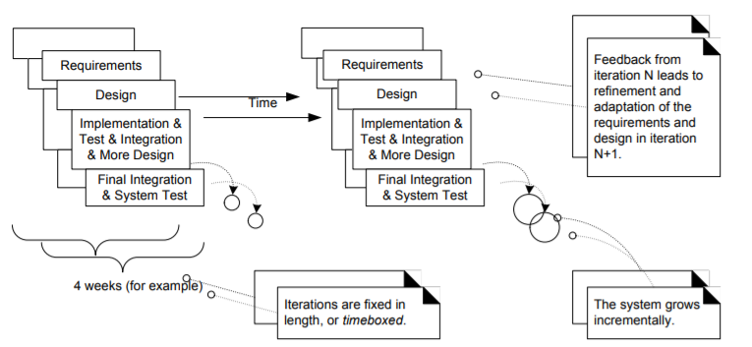
Iterative and Evolutionary Development

Slide 11
How to Handle Change in an Iterative Project?
Do you specify, freeze, and "sign off" on a set of requirements?
Iterative development is based on an attitude of embracing change and adaptation as unavoidable

Slide 12
How to Handle Change in an Iterative Project?
Each iteration involves choosing a small subset of the requirements, and quickly designing, implementing, and testing
Taking a small step before all requirements are finalized leads to rapid feedback

Slide 13
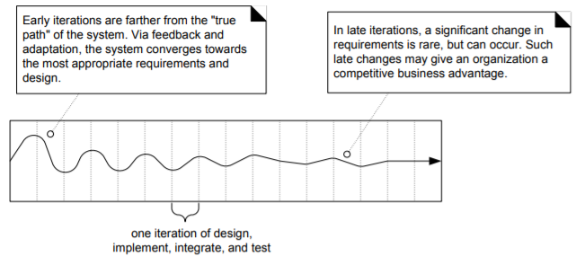
Iterative Feedback and Adaptation

Slide 14
Benefits of Iterative Development
Less project failure, better productivity, lower defect rates
Early mitigation of high risks (technical, requirements, objectives, usability, and so forth)
Early visible progress
Early feedback, user engagement, and adaptation, leading to a refined sys tem that more closely meets the real needs of the stakeholders
Managed complexity; the team is not overwhelmed by "analysis paralysis" or very long and complex steps
The learning within an iteration can be methodically used to improve the development process itself, iteration by iteration

Slide 15
Iteration Length & Timeboxing
How long should your iteration be?
Timeboxed: Fixed in Length
So what if you can’t complete the task by the scheduled date?
Normal Length: 3-6 weeks

Slide 16
Waterfall Thinking
How do you know if you’re following the waterfall thinking in an Iterative Project?
Notes:
What is the Waterfall Model?
Requirement Gathering and analysis − All possible requirements of the system to be developed are captured in this phase and documented in a requirement specification document.
System Design − The requirement specifications from first phase are studied in this phase and the system design is prepared. This system design helps in specifying hardware and system requirements and helps in defining the overall system architecture.
Implementation − With inputs from the system design, the system is first developed in small programs called units, which are integrated in the next phase. Each unit is developed and tested for its functionality, which is referred to as Unit Testing.
Integration and Testing − All the units developed in the implementation phase are integrated into a system after testing of each unit. Post integration the entire system is tested for any faults and failures.
Deployment of system − Once the functional and non-functional testing is done; the product is deployed in the customer environment or released into the market.
Maintenance − There are some issues which come up in the client environment. To fix those issues, patches are released. Also to enhance the product some better versions are released. Maintenance is done to deliver these changes in the customer environment.

Slide 17
Fin.

